Slide 1
Robot Framework Introduction
自動化開發與認證課
David_Zhu
2022/5/10

Slide 2
Agenda
VS Code & Python Installation
Robot Framework & Extensions Installation
Robot Framework Introduction
Automation Tool Introduction
Demo

Slide 3
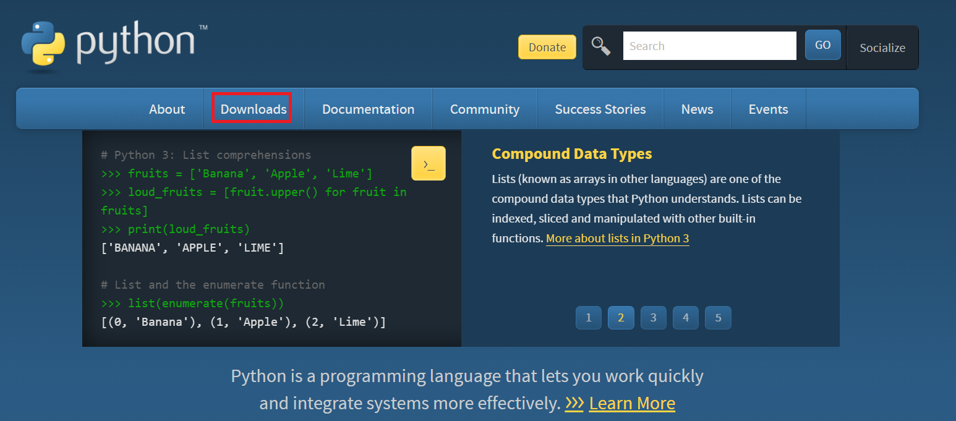
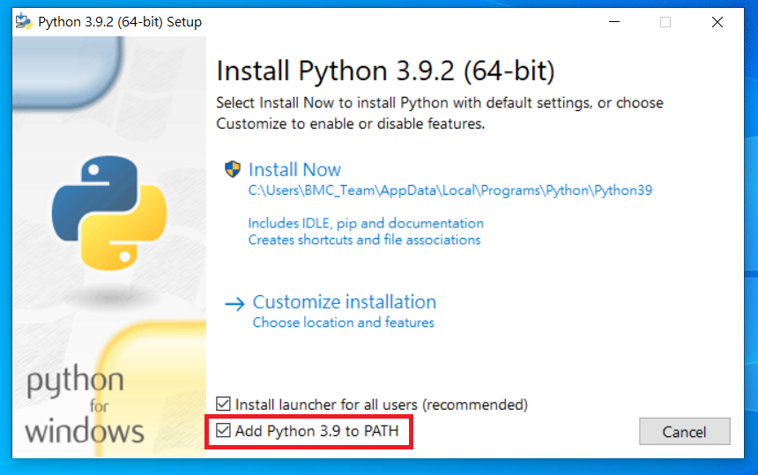
Python – Robot Framework
VS code & Python Installation
Download : https://www.python.org/downloads/

Slide 4
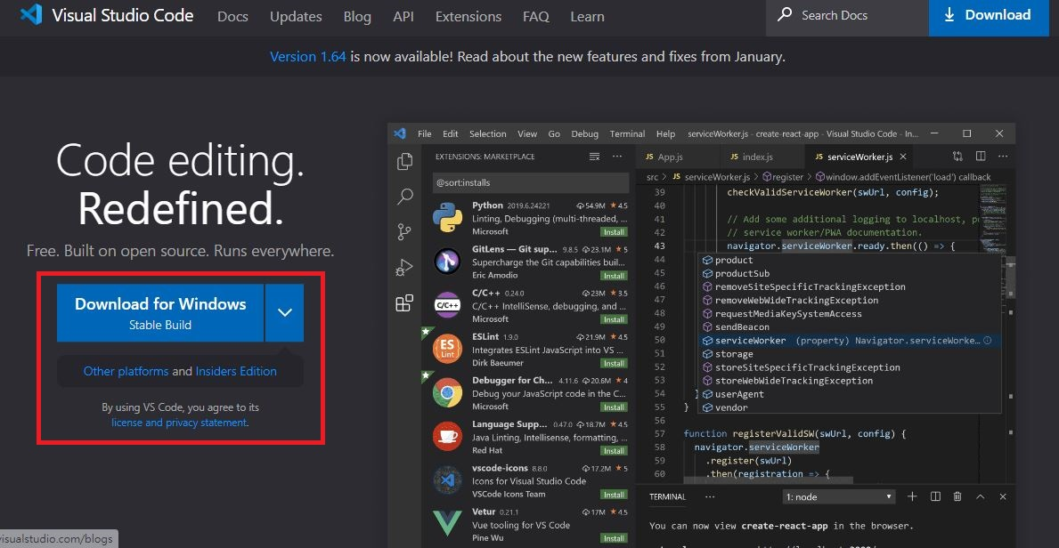
Python – Robot Framework
VS code & Python Installation
Download : https://code.visualstudio.com/

Slide 5
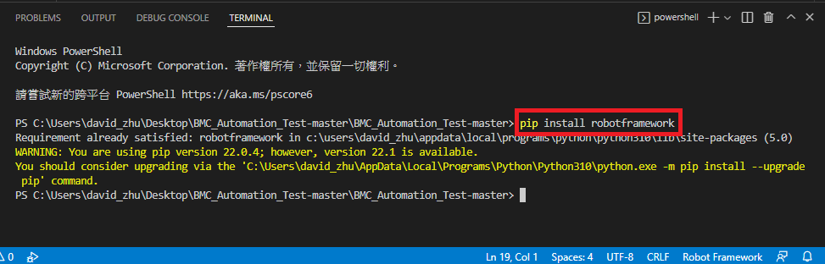
Python – Robot Framework
Robot Framework Installation
$ pip install -r requirements.txt

Slide 6
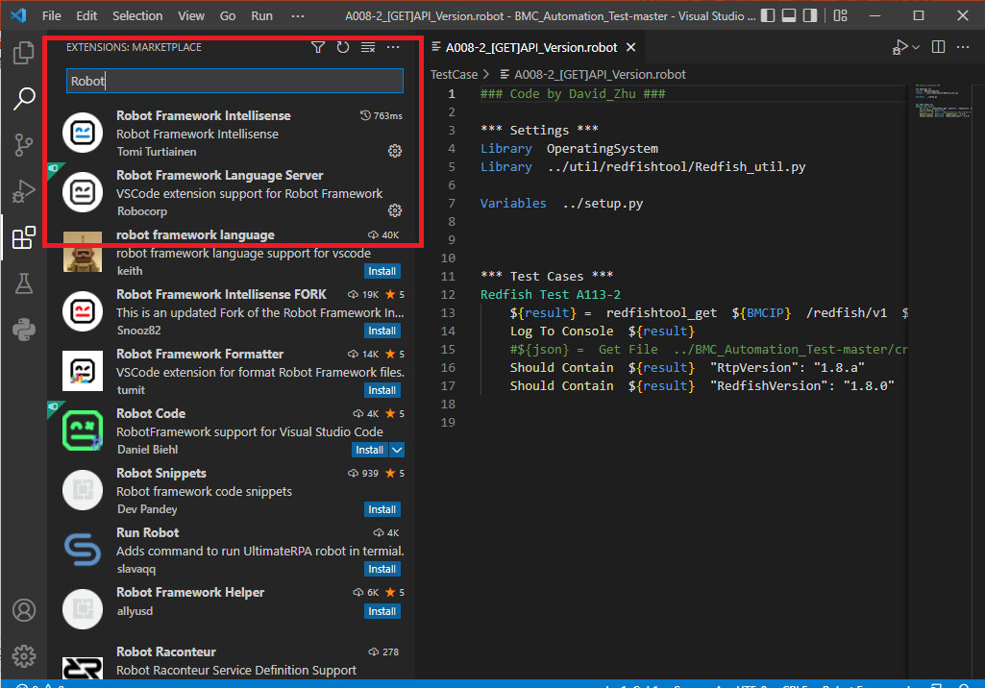
Python – Robot Framework
Robot Framework Extensions Installation

Slide 7
Python – Robot Framework
Robot Framework
Base on Python Language to implement.
Robot Framework program grammar easy for automation used.
Robot Framework have below function.
Automation test report creation
Automation test case execution
Pass / Fail result determination

Slide 8
Python – Robot Framework
Robot Framework Format
*** Settings ***
Library value
Resource value
Variables value
Suit Setup value
Suit Teardown value
*** Variable ***
${Var} value
*** Keyword ***
Function_Name Action
*** Test Case ***
Test_Case Step_Action

Slide 9
Python – Robot Framework
Robot Framework (Settings block)
Used for package import
Keyword
- Library : Import python package
- Resource : Import robot package
- Suit Setup : Execute the test preliminary work before test
- Suit Teardown : Recovery the setting after test
Settings | Value | Value | Value
Library | ../util/ipmitool/IPMI_util.py
Resource | ../util/ipmitool/IPMI_Power_Control.robot
Variables | ../setup.py
Suit Setup | Launch Browser and Login GUI
Suit Teardown | Close Browser

Slide 10
Python – Robot Framework
Robot Framework (Variable block)
Used for variable declare.
Variable can be named by user.
Used ${ } format to define variable name.
Variable | Value | Value
${xpath_hardware_status_heading} | //*[@id="main"]/div/div/aside[1]/div/section/ul/li[11]/a
${BMCWeb} = | https://${BMCIP}

Slide 11
Python – Robot Framework
Robot Framework (Keyword block)
Function declare for used.
Function can be named by user.
Used Robot Framework Keyword [Arguments] to define function arguments.
Keyword | Action | Argument | Argument | Argument | Argument | Argument | Argument
Chassis Power On | [Arguments] | (Optional)
 | ${result} = | ipmicmd | lanplus | ${USERID} | ${PASSWORD} | ${BMCIP} | chassis power on
 | Log To Console | ${result}
 | Should Contain | ${result} | Up/On
 | ……………

Slide 12
Python – Robot Framework
Robot Framework - In common use Keyword
Run Keyword and Return Status
Wait Until Page Contains Element
Should Be Equal
Set Test Variable
Run Keyword If
Click Element
Double Click Element
Sleep
Element Attribute Should Contain Text

Slide 13
Python – Robot Framework
Robot Framework (Test Case block)
Test Case step defined.
Test Case check point defined.
Test Case step can call Function (Keyword) what you want to test.
Used Robot Framework Keyword [Documentation] to define test description
Test Case | Action | Argument | Argument
BMC Web Power Off Server Immediate | [Documentation] | Verify BMC Power Control From WebUI
 | Wait Until Element Is Visible | //*[@id="main"]/div/header/label
 | Click Element | //*[@id="main"]/div/div/aside[1]/div/section/ul/li[11]/a
 | Sleep | ${OSDelay}
 | Capture Page Screenshot
 | ……………

Slide 14
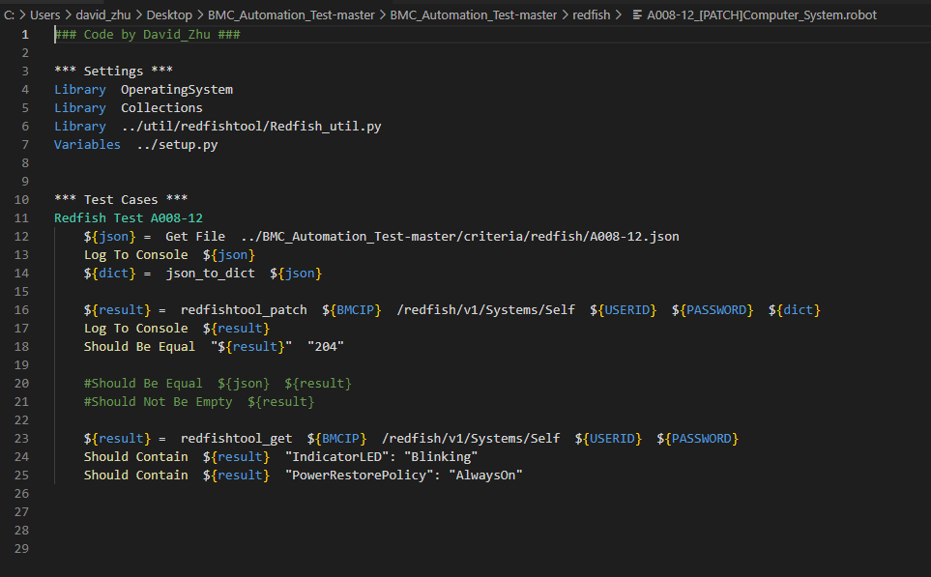
Python – Robot Framework
Robot Framework – Redfish PATCH Test
Settings : Used to Import the python package or other Robot script witch need to used.
Test Cases : Used to design the test step of the test target, it can be assigned the multiple test case to do the sequential test.
Redfish Function test : Call Redfish function to do the PATCH test, used Robot Framework Keyword “Should Be Equal ” to compare the response.

Slide 15
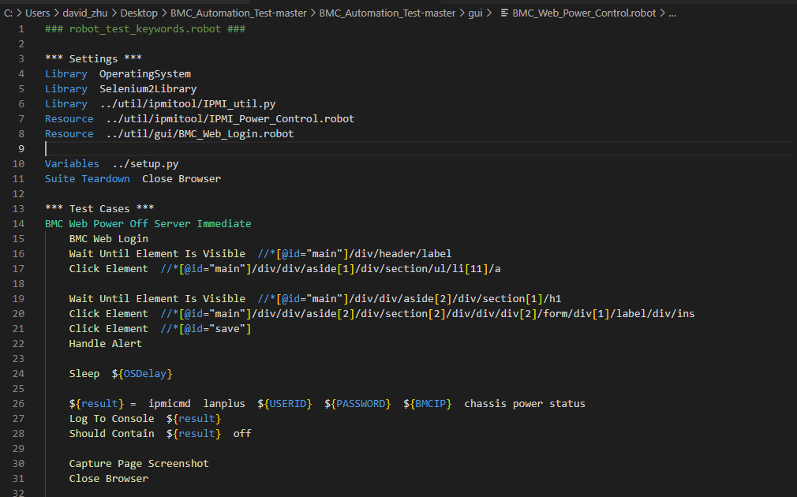
Python – Robot Framework
Robot Framework- Web UI Test
Variables : Used for variable declare, If test on WebUI, it can used to declare the WebUI source code. (Press F12 to get the Web item Xpath)
WebUI Control : Base on Selenium2 Framework and used Robot Framework Keyword “Click Element ” control WebUI to click items.
WebUI Test : After WebUI Test finished, can used Robot Framework Keyword “Capture Page Screenshot” to capture the Web page and then Close the Broswer

Slide 16
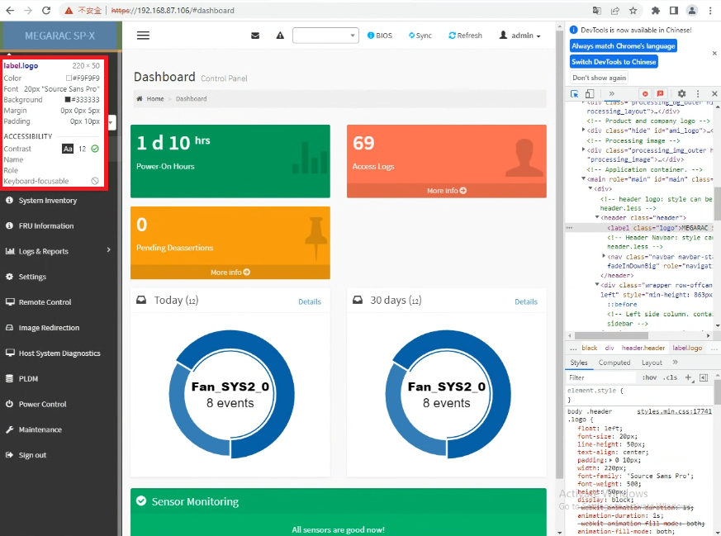
Python – Robot Framework
Selenium Framework- Web UI Control
Web Source code : Press F12 to get the Web item Xpath, Selenium framework need to get the web item Xpath and depend on WebDriver to control the web.
Chrome : ChromeDriver
Firefox : FirefoxDriver

Slide 17
Automation Tool Introduction

Slide 18
Automation Tool Introduction
Automation Related Technical
- Environment requirement as below
Windows OS
Python 3
Robot Framework
For automation test and test report creation
Ipmitool
For IPMI command used
Redfishtool
For REST method GET / POST / PATCH / DEL used
Selenium2Library
For Web GUI automation test control (Web motion control)

Slide 19
Automation Tool Introduction
Automation Tool Environment Setting
The newest python installation.
Need to execute "pip install -r requirements.txt" at the BMC_Automation_Test folder to install the related python package.
"BMC_Automation_Test/drivers" folder need to add the environment variable on Windows OS.
"util" folder need to add the environment variable on Windows OS.
Google Chrome need to used Version 100.0.4896.127 above.

Slide 20
Automation Tool Introduction
Automation Tool Setup and Run
Set the related parameter about BMC IP, Username, Password and others on GUI interface.
Execute the GUIsetup.py by command "Python GUIsetup.py" to launch the GUI interface.
Execute the command "robot TestCase\\${TestCaseName}" to used by command line.
After test finished, you can check the Test report under the "BMC_Automation_Test" folder.
This tool can test BMC function which TestCase you add in the TestCase folder.

Slide 21
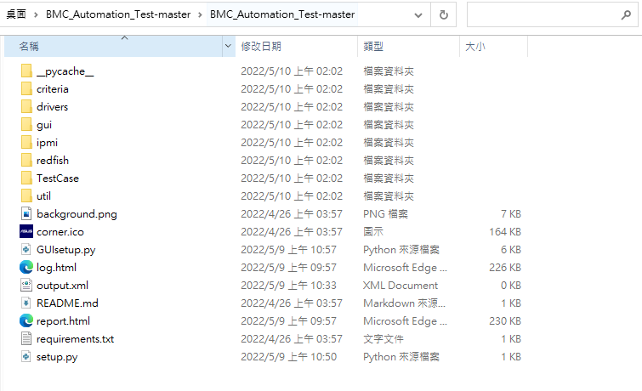
Automation Tool Introduction
Automation Tool Architecture
Criteria Define
Web Driver
Test Case Define
Related Tool
GUI Setup
Test Report

Slide 22
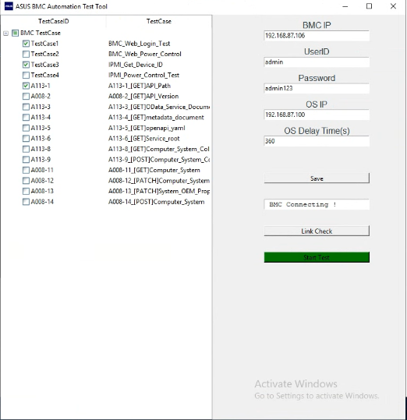
Automation Tool Introduction
Automation Tool GUI
Test Case Selection
Configure Setup
BMC Connection Check
Start Test

Slide 23
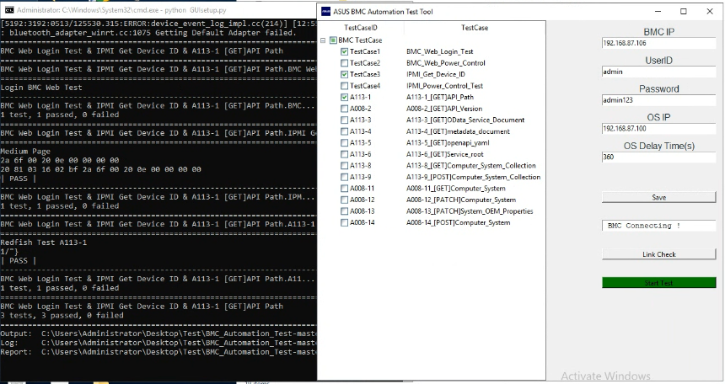
Automation Tool Introduction
Automation Tool Test Run

Slide 24
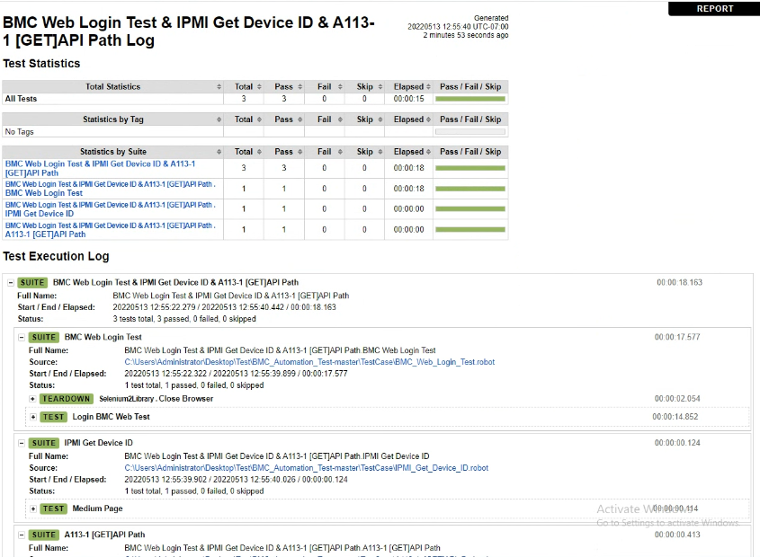
Automation Tool Introduction
Automation Tool Test Report

Slide 25
Automation Tool Introduction
Demo

Slide 26
Automation Tool Introduction
Reference
Robot Framework User Guide
https://robotframework.org/#development
Python Download
https://www.python.org/downloads/
VS Code Download
https://code.visualstudio.com/

